Slide 1
3D Computer Vision
Dr. Hassan Foroosh
School of EECS
UCF

Slide 2

Single view geometry
Camera model
Camera calibration
Single view geom.

Slide 3
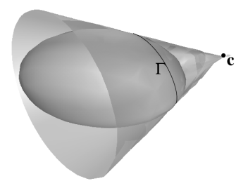


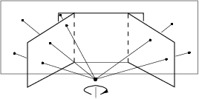
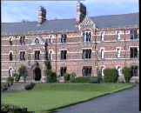
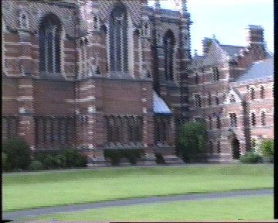
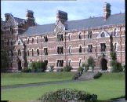
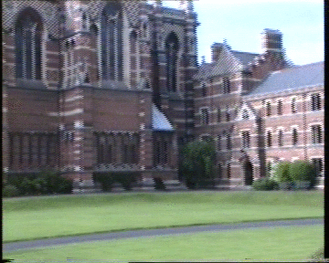


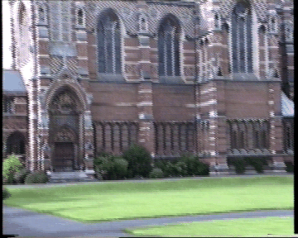
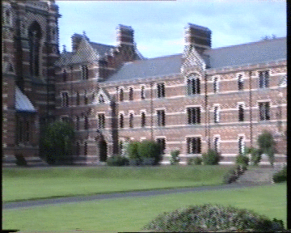

Last Time
Projective cameras and planes, lines, conics.
Fixed Camera Center

Slide 4
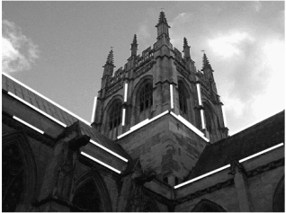

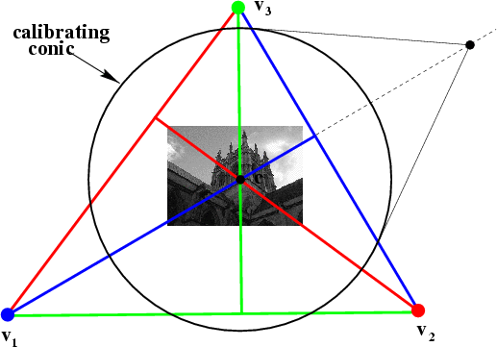
Today
Camera calibration and vanishing points, calibrating conic and the IAC

Slide 5
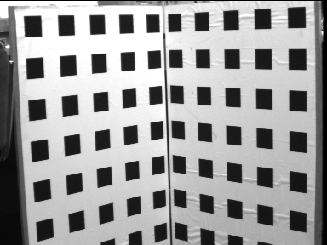


Old Fashion Calibration

Slide 6
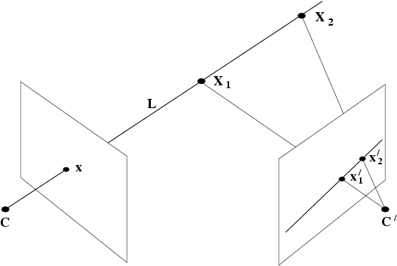
Moving the camera center
motion parallax
epipolar line

Slide 7
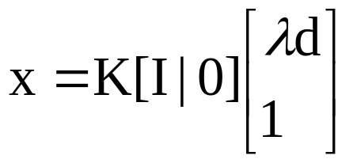
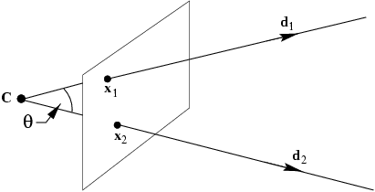

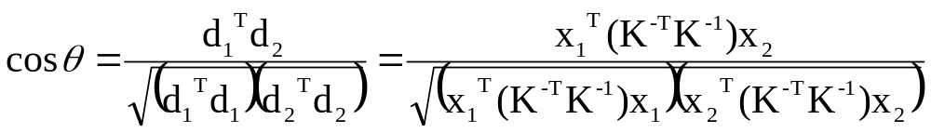
What does calibration give?
An image l defines a plane through the camera center with normal n=K^{T}l measured in the camera’s Euclidean frame

Slide 8
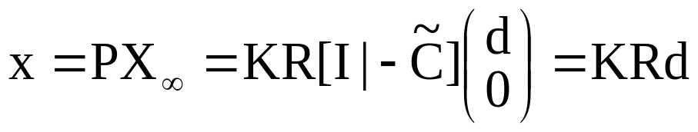
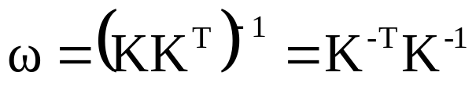
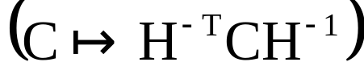
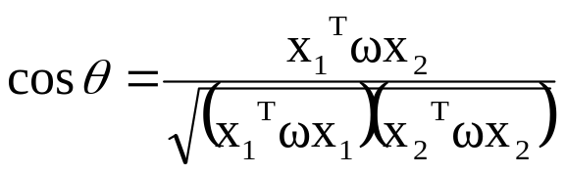
The image of the absolute conic
mapping between π∞ to an image is given by the planar homogaphy x=Hd, with H=KR
image of the absolute conic (IAC)
IAC depends only on intrinsics
angle between two rays
DIAC=ω*=KK^{T}
ω ⇔ K (cholesky factorisation)
image of circular points

Slide 9
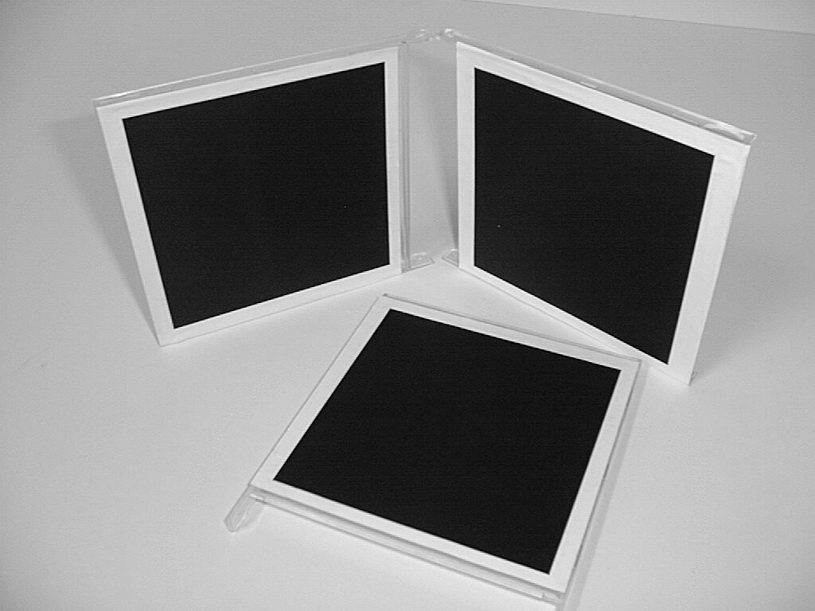
A simple calibration device
compute H for each square
(corners (0,0),(1,0),(0,1),(1,1))
compute the imaged circular points H(1,±i,0)^{T}
fit a conic to 6 circular points
compute K from ω through cholesky factorization
(= Zhang’s calibration method)

Slide 10
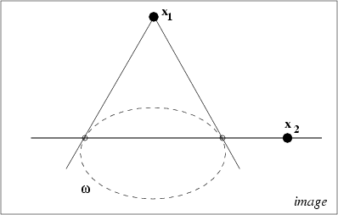
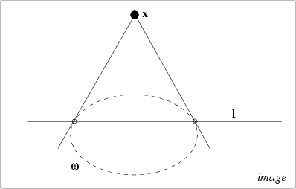
Orthogonality = pole-polar w.r.t. IAC

Slide 11
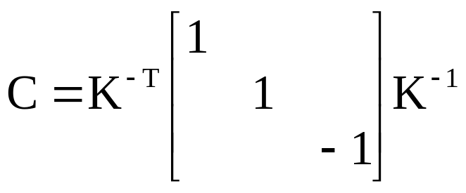
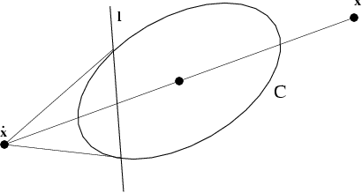
The calibrating conic

Slide 12
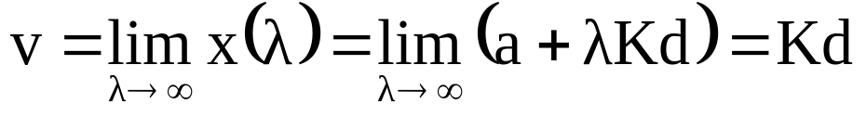

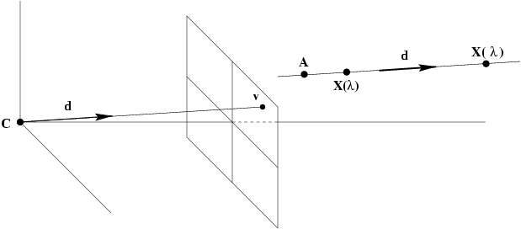
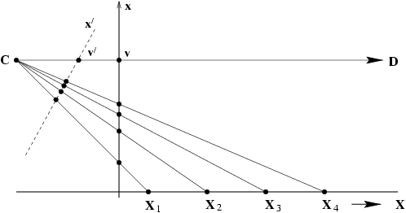
Vanishing points

Slide 13
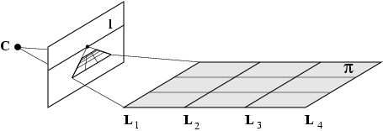
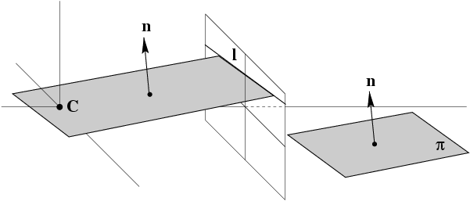
Vanishing lines

Slide 14
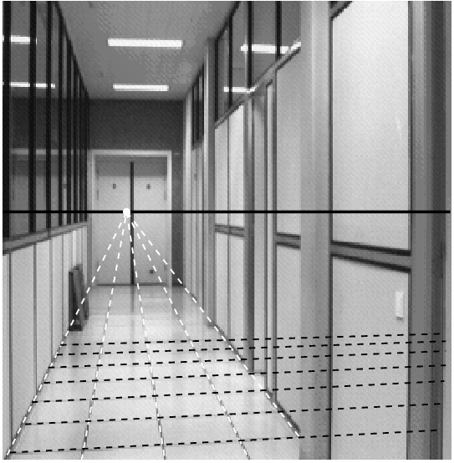
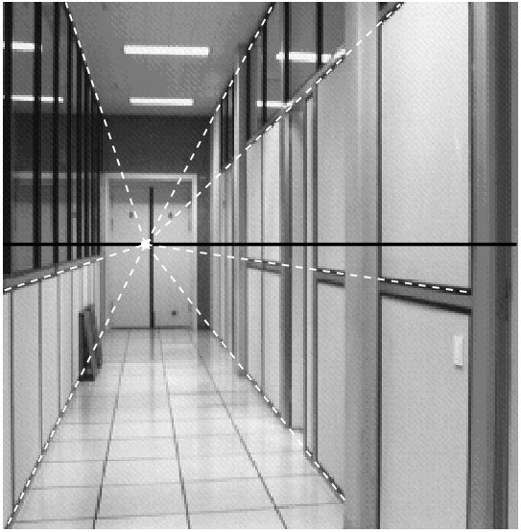


Slide 15

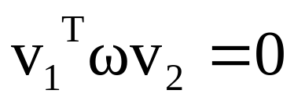
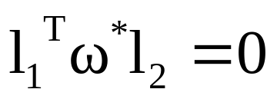
Orthogonality relation

Slide 16

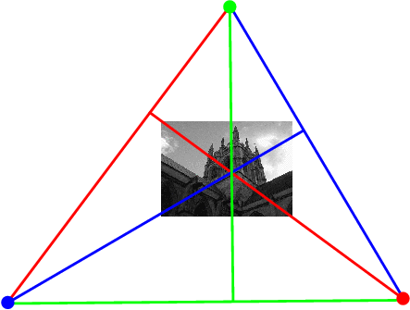

Calibration from vanishing points & lines

Slide 17
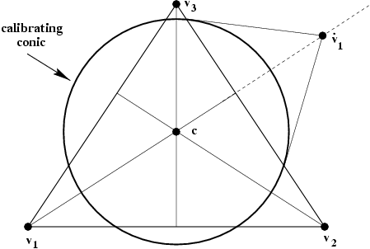
Calibration from vanishing points & lines

